Slide 1
Editable Images for
formatting_plots
And plot help docs pages for:
1D and Tiled, Waterfall, Colorfill and Contour, 3D Plots

Slide 2














PlotToolbarWaterfall.png
Arrows
ZOOM LEVELS
Zoom
Copy
IMAGE
Save
IMAGE FILE
Print
ORDER
REVERSE
OFFSET
FILL
Fit
Home
RESET
AXES
Drag
L-clk PAN
R-clk STRETCH
Grids
ON / OFF
Options
MENU
Waterfall
Help
PLOT
DOCS
Hide
in Plots
Toolbox
FITTING
TAB
Get Icons here: https://materialdesignicons.com/

Slide 3


Arrows
ZOOM LEVELS
Zoom
Copy
IMAGE
Save
IMAGE FILE
Print
Script
SAVE / COPY
ORDER
REVERSE
OFFSET
FILL
Fit
Superplot
Home
RESET
AXES
Drag
L-clk PAN
R-clk STRETCH
Grids
ON / OFF
Options
MENU
SUPERPLOT
TAB
Waterfall
Color
CONTOUR/
WIREFRAME
Help
PLOT
DOCS
Hide
in Plots
Toolbox
FITTING
TAB
PlotToolbar.png (Overall)
[ You may need to take 2 screen shots of this, and stitch together, as it is too long for one slide!]
Arrows
ZOOM LEVELS
Zoom
Copy
IMAGE
Save
IMAGE FILE
Print
Script
SAVE / COPY
Fit
Superplot
Home
RESET
AXES
Drag
L-clk PAN
R-clk STRETCH
Grids
ON / OFF
Options
MENU
SUPERPLOT
TAB
Help
PLOT
DOCS
Hide
in Plots
Toolbox
FITTING
TAB
PlotToolbar1DSpectrum.png

Slide 4
Arrows
ZOOM LEVELS
Zoom
Copy
IMAGE
Save
IMAGE FILE
Print
Script
SAVE / COPY
PlotToolbarTiledColorfill.png
Home
RESET
AXES
Drag
L-clk PAN
R-clk STRETCH
Grids
ON / OFF
Options
MENU
Help
PLOT
DOCS
Hide
in Plots
Toolbox
Copy
IMAGE
Save
IMAGE FILE
Print
PlotToolbar3DSurface.png
Home
RESET
AXES
Grids
ON / OFF
Options
MENU
Help
PLOT
DOCS
Hide
in Plots
Toolbox
Arrows
ZOOM LEVELS
Zoom
Copy
IMAGE
Save
IMAGE FILE
Print
PlotToolbarContour.png
Home
RESET
AXES
Drag
L-clk PAN
R-clk STRETCH
Grids
ON / OFF
Options
MENU
Contour
LINE
COLOR
Help
PLOT
DOCS
Hide
in Plots
Toolbox

Slide 5
PlotToolbarWaterfallMenus.png
Copy
IMAGE
Save
IMAGE FILE
Print
PlotToolbar3DWireframe.png
Home
RESET
AXES
Grids
ON / OFF
Options
MENU
Color
CONTOUR/
WIREFRAME
Help
PLOT
DOCS
Hide
in Plots
Toolbox

Slide 6
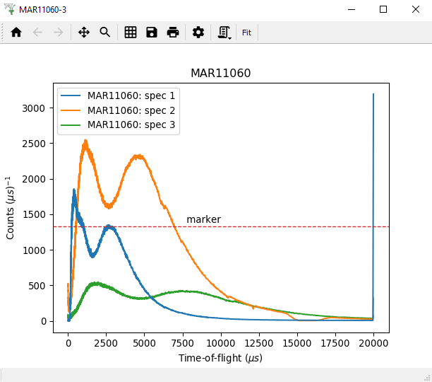
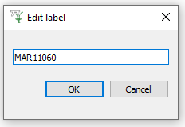

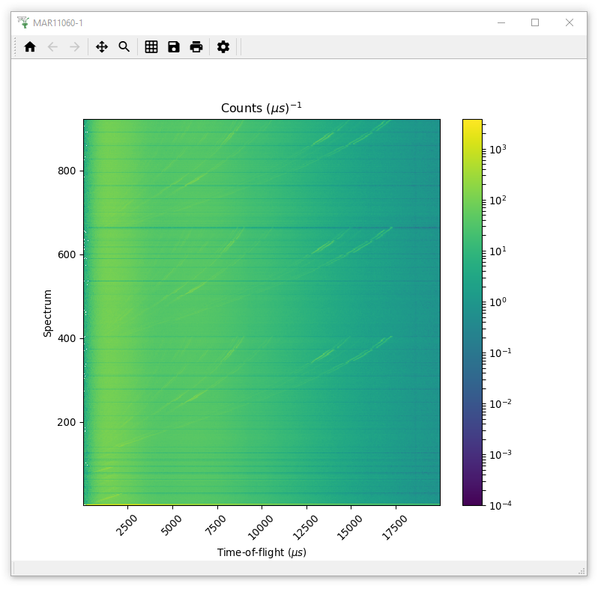
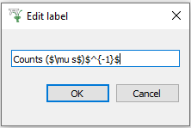

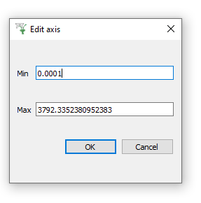
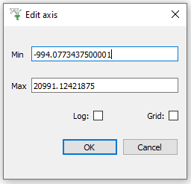
PlotClickMenus.png
1D PLOT
COLORFILL
Axes
LINEAR / LOGARITHMIC
Normalization
NONE / by BIN WIDTH
Error Bars
SHOW / HIDE
Markers
HORZ / VERT LINE
Plot Type
1D / WATERFALL
Axes
Normalization
Color bar
LINEAR / LOGARITHMIC
Double-Click
Right-Click

Slide 7
PlotClickMenus1D.png
1D PLOT
Axes
LINEAR / LOGARITHMIC
Normalization
NONE / by BIN WIDTH
Error Bars
SHOW / HIDE
Markers
HORZ / VERT LINE
Plot Type
1D / WATERFALL
Double-Click
Right-Click

Slide 8
PlotClickMenusTiled.png
Tiled PLOT
Axes
LINEAR / LOGARITHMIC
Normalization
NONE / by BIN WIDTH
Error Bars
SHOW / HIDE
Markers
HORZ / VERT LINE
Double-Click
Right-Click

Slide 9
PlotClickMenusColorfill.png
Axes
LINEAR / LOGARITHMIC
Normalization
NONE / by BIN WIDTH
Color bar
LINEAR / LOGARITHMIC
Double-Click
Right-Click

Slide 10
PlotClickMenusContour.png
Axes
LINEAR / LOGARITHMIC
Normalization
NONE / by BIN WIDTH
Color bar
LINEAR / LOGARITHMIC
Double-Click
Right-Click

Slide 11
PlotClickMenusWaterfall.png
Axes
LINEAR / LOGARITHMIC
Normalization
NONE / by BIN WIDTH
Error Bars
SHOW / HIDE
Markers
HORZ / VERT LINE
Plot Type
1D / WATERFALL
Double-Click
Right-Click

Slide 12
ptions Menu
FigureOptionsGear.png

Slide 13
(0, 0)
(0, 1)
(1, 0)
(1, 1)
PlotOptionsTiledAxes.png

Slide 14
1D PLOT
IMPORTANT FOR
TILED PLOTS
SELECT AXIS
DISABLED for NON-3D
e.g.
Counts (μs)⁻¹
LINEAR / LOG / SYMLOG / LOGIT
PlotOptions.png
FORMATTING

Slide 15
PlotOptionsTiled.png
IMPORTANT FOR
TILED PLOTS
SELECT AXIS
DISABLED for NON-3D
e.g.
Counts (μs)⁻¹
LINEAR / LOG / SYMLOG / LOGIT
FORMATTING

Slide 16

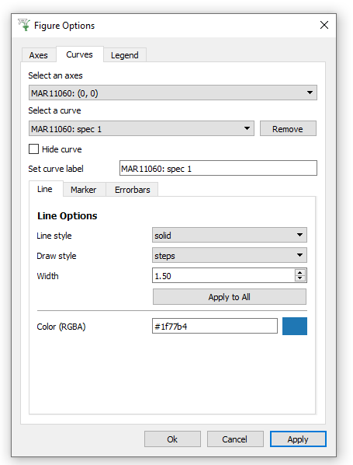
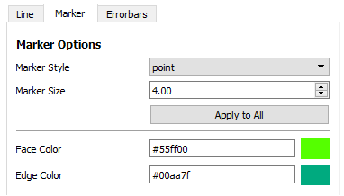
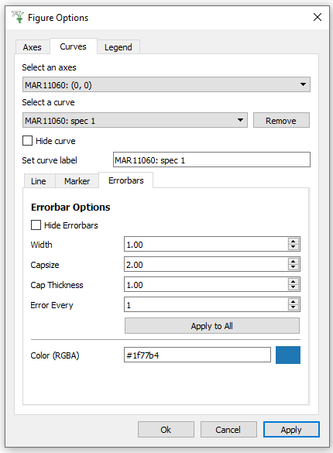
1D PLOT and Tiled
PlotOptionsCurves.png
SELECT A SPECTRUM
EDIT ALL SPECTRA
EDIT SELECTED SPECTRUM

Slide 17
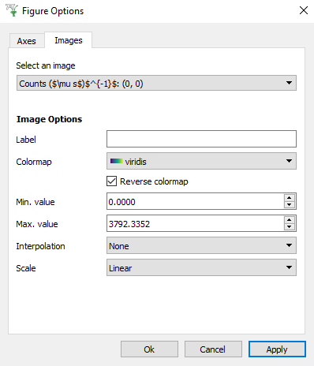
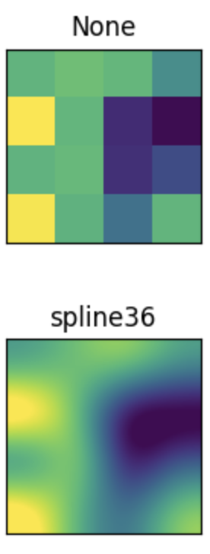
PlotOptionsColorfill.png
COLORFILL
LINEAR /
LOGARITHMIC

Slide 18
IMPORTANT FOR
TILED PLOTS
DISABLED for NON-3D
SELECT AXIS
e.g.
TOF (μs)⁻¹
LINEAR / LOG / SYMLOG / LOGIT
LINEAR /
LOGARITHMIC
PlotOptionsColorfillContour.png
COLORFILL HELP

Slide 19
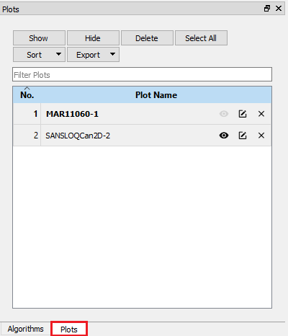




Plots
Show
Hide
Delete
Select All
FIND + ORGANISE
Sort
Export
Filter Plots
No. Plot Name
1 | MAR11060-1
2 | SANSLOQCan2D-2
SELECTED PLOTS APPEAR BOLD
HIDE/
SHOW
RENAME
DELETE
Algorithms
Plots
OPEN PLOTS TOOLBOX
PlotsWindow.png ^^^ All Faked ^^^
^^^ Real Mantid Screenshot ^^^

Slide 20
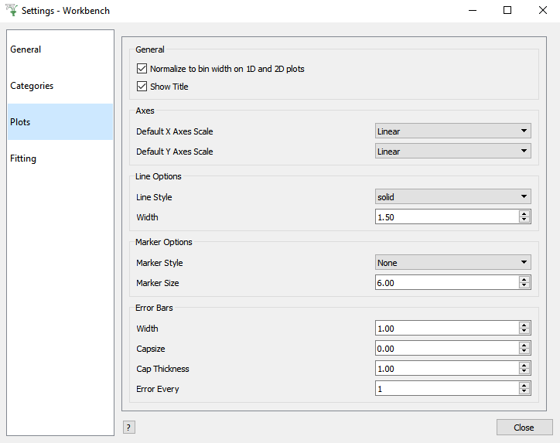
PlotSettings.png
LINEAR / LOGARITHMIC

Slide 21
PlotClickMenus3DWireframe.png
ColorPaletteWireframeContour.png
WIREFRAME
Double-Click

Slide 22
SELECT AXIS
e.g.
TOF (μs)
DISABLED for 3D
PlotOptions3DWireframe.png

Slide 23
SELECT AXIS
e.g.
Counts (μs)⁻¹
DISABLED for 3D
LINEAR /
LOGARITHMIC
DISABLED for 3D
PlotOptions3DSurface.png

Slide 24
SURFACE
Double-Click
PlotClickMenus3DSurface.png
Right-Click
Color bar
LINEAR / LOGARITHMIC

Slide 25
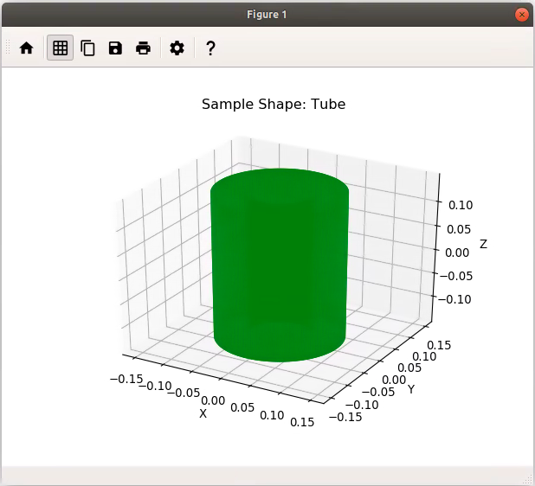
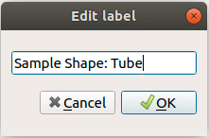
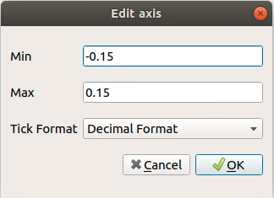
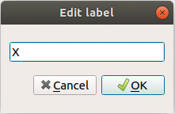
PlotClickMenus3DMesh.png
MESH Polygon
Double-Click

